Slide 1

Hermes
An open-source “game” library for Processing

Slide 2
→ Supports both traditional and non-traditional
conceptions of game.
→ built for the Processing community
→ the process of creating a game is defining
    a set of rules.

Slide 3
General Design Goals
Ease of use – can be used by even a relatively inexperienced programmer.
Robustness – will still be relevant and sufficiently powerful for a more advanced programmer.
Modularity – utilities such as animation, the post office, and physics can be used independently of the core framework.
Self-contained – doesn't require knowledge of any other library except Processing and Java.

Slide 4
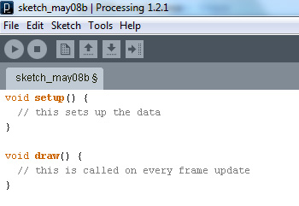
This is a Processing sketch:
→ we've added a second loop: the World update loop

Slide 5
The Core
World – automates the game update loop. Runs on its own thread, so drawing and game logic are parallel.
Being – a spatially located object, such as a character or platform. Has abstract draw() and update() methods.
Interactor – interface for the “rules” by which beings interact. Has detect() and handle() methods.
Camera – provides a view into the World. Draws registered Beings. Handles coordinate transforms.

Slide 6
The Post Office
→ Handles I/O with the outside world.
→ Objects can subscribe to messages, they can come from the mouse or the keyboard, or from some external program via OSC.
→ The post office queues messages as they come in and dispatches them on command, preventing threading issues.

Slide 7
Physics
Shape system – implementations for axis-aligned bounding box, circle, and arbitrary convex polygon. Collision detection for these shapes, using double dispatch.
MassedBeing – an extension of Being with support for force and impulse accelerations, and multisampling.
Collisions – robust impulse and projection-based collision response. Variable elasticity.
→ why write our own?

Slide 8
Animations
– works hand-in-hand with Processing's PImage functionality
– basically a beat slicer/arpeggiator for images
– variable playback speed, can play forwards or backwards
– can slice tile maps, or load images from frame sequences

Slide 9
Demos!!!

